Slide 1

Using NLP to extract Salient User Reviews
Siyi Ge
Advisor : Prof. Donghui Yan

Slide 2
Introduction
Why is Customer Review Important?
To Business
Improve Customer Service
Credibility
Improve Rankings
Advertisement
To Customer
Gain Experience
Customer Voice / Relationship with Business
Customer Review Matter:
57% of consumers only use a business over 4 stars
80% of 18-34-year-olds consumers have written reviews
91% of 18-34-year-old consumers trust online reviews
A one-star increase in Yelp rating leads to a 5-9 percent increase in revenue
Information Overload Problem
Huge Amount of Online Reviews
Time Consuming
Reliability

Slide 3
Structure
Review Dataset
Text Cleaning
Sentiment Analysis
Text Summarization

Slide 4
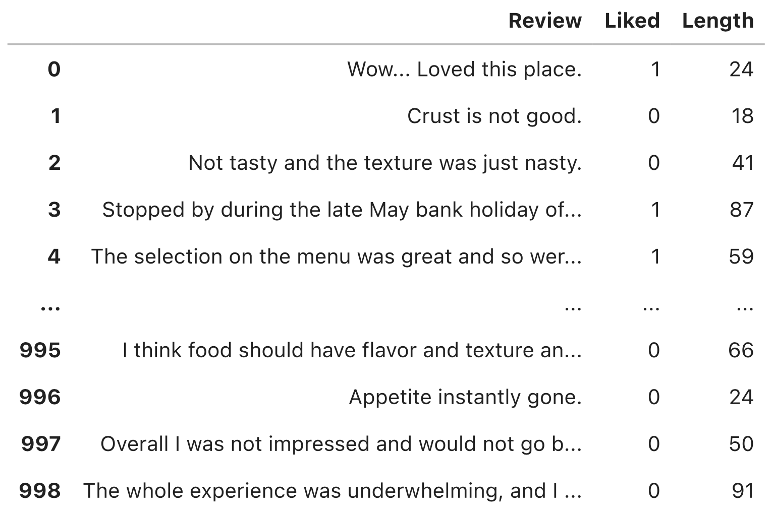
Data
Top Frequent Review
Negative : I would not recommend this place.
Positive : I love this place.

Slide 5

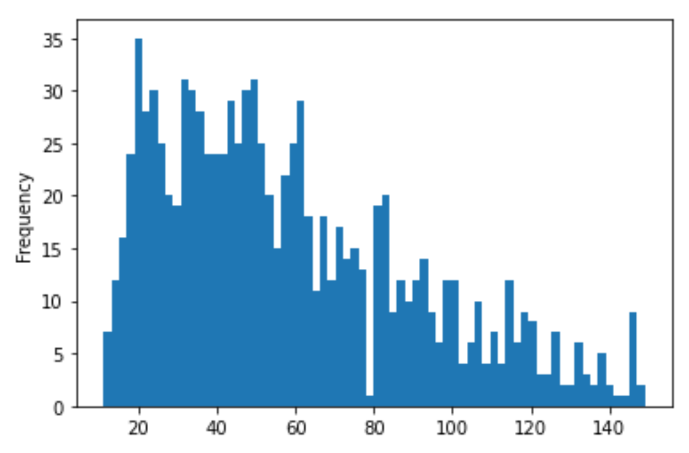
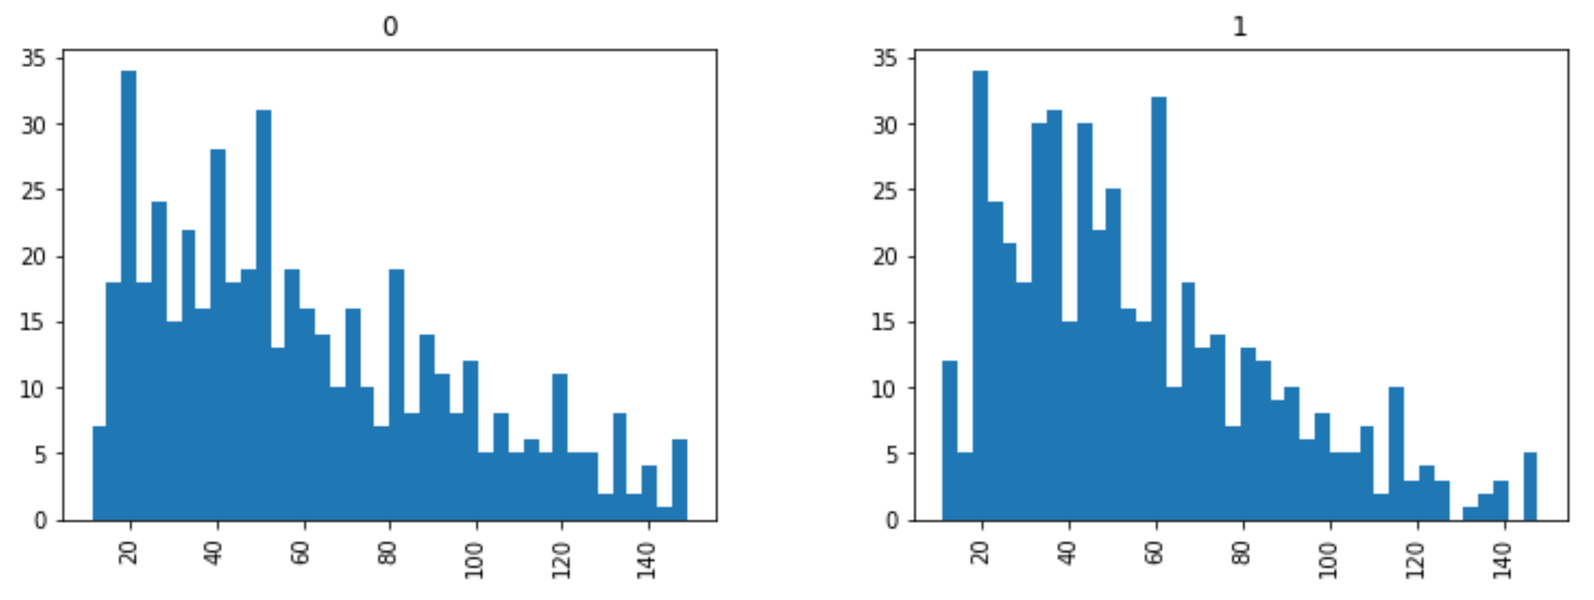
Review Length
Mean : 58.325
Min : 11
Max : 149
'The problem I have is that they charge $11.99 for a sandwich that is no bigger than a Subway sub (which offers better and more amount of vegetables).'

Slide 6
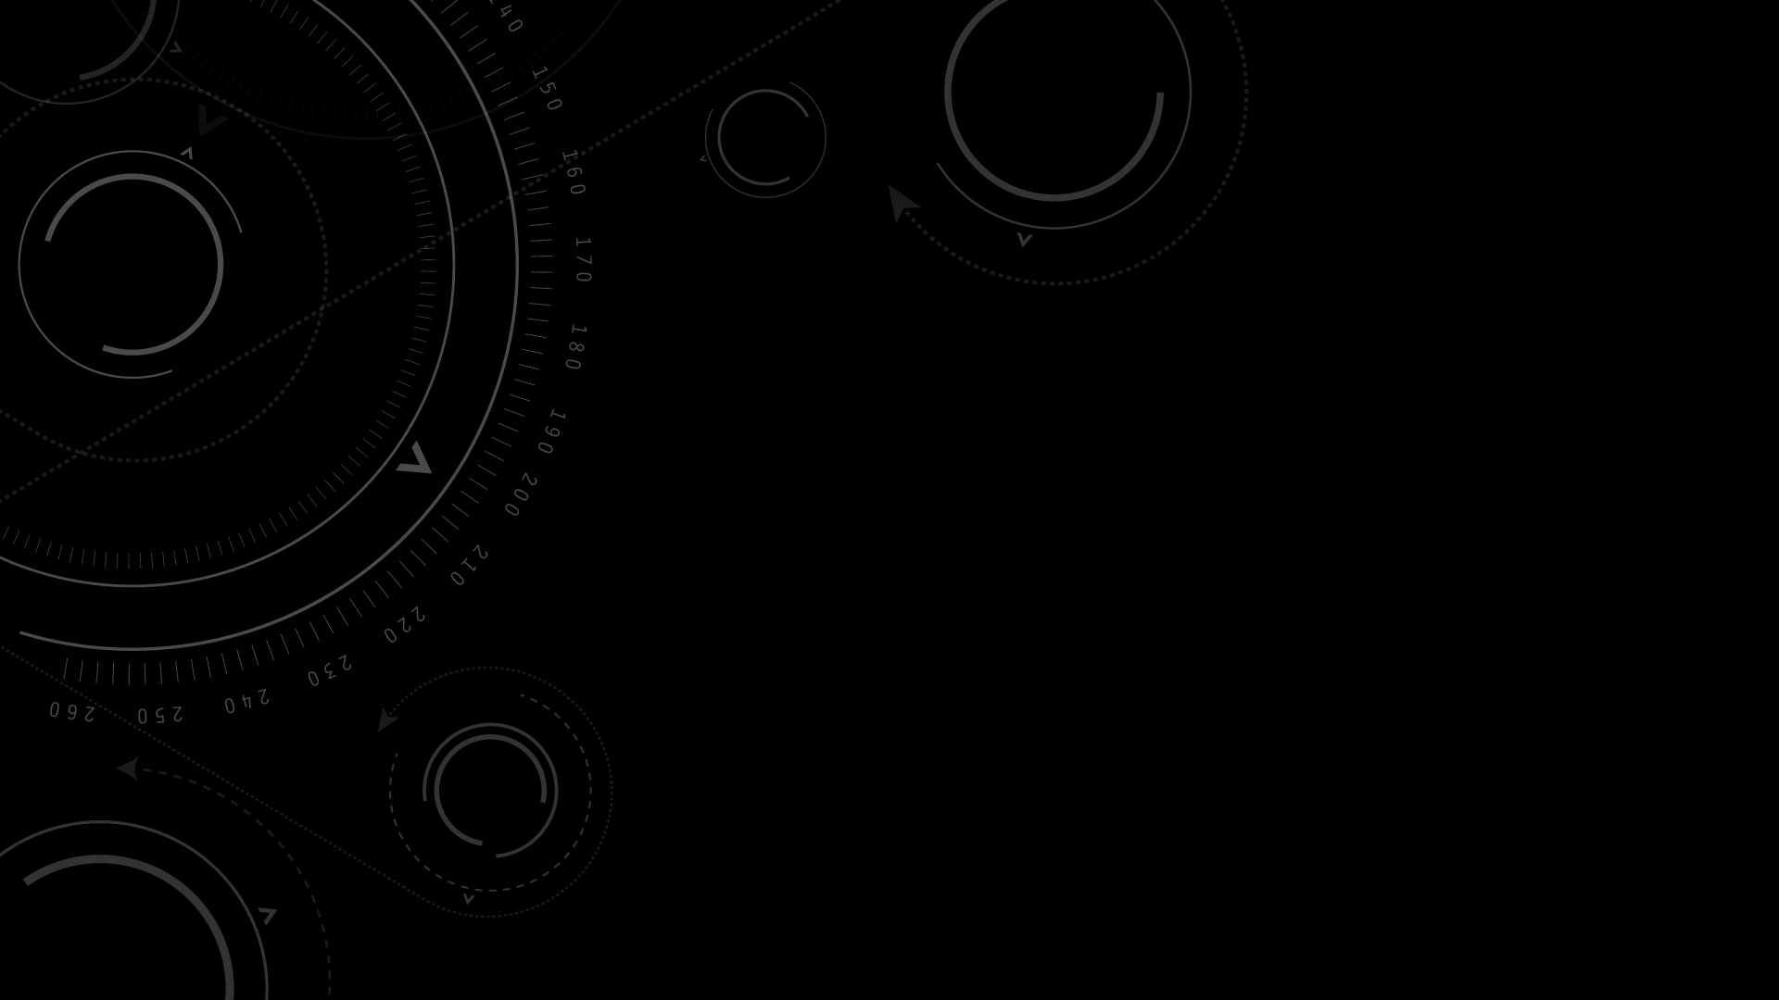
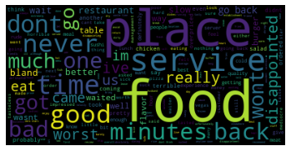
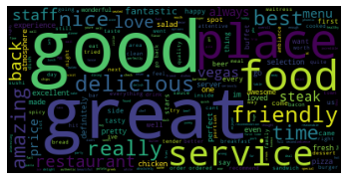
Word Cloud
Negative
Positive

Slide 7
Data preprocessing
Text Cleaning
Remove Punctuations
Stemming
Convert to lower case
Text Cleaning
Tokenization
Original
Wow... Loved this place.
wow love place
Crust is not good.
Not tasty and the texture was just nasty.
crust good
tasti textur nasti
wow, love, place
crust, good
tasti, textur, nasti
“waiting”
“waits”
“waited”
Stemming
wait

Slide 8
Sentiment analysis Pipeline
Training
Tags
(Positive or Negative)
Machine Learning Algorithm
(Random Forest)
Reviews
Feature Extractor
Features
Prediction
Predictive Model
Reviews
Feature Extractor
Features
Tags
(Positive or Negative)

Slide 9
Predictive model
Feature Selection
Bag of Words
Matrix of Token Counts
Predictive Model
Training and Testing set
absolut, accid, accomod…
bacon, bad, base, bit…
café, cake, calamari, carb…
.
.
.
wait, wash, watch, water…
ya, year, yellow…
zero
Review1 : wow love place
Review2: fri great
Review3: great way finish great
Training and Testing
70 | 30
X - bag of words
Y – 0 or 1
finish | fri | great | love | place | wow | way
 |  |  | 1 | 1 | 1
 | 1 | 1
1 |  | 2 |  |  |  | 1

Slide 10
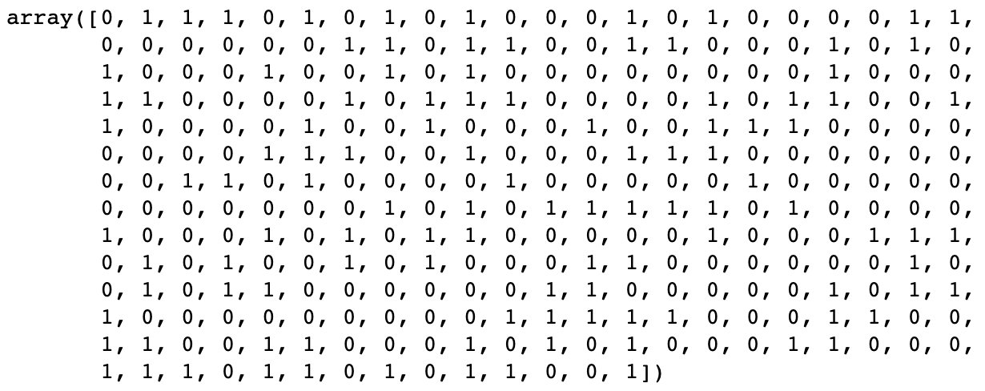
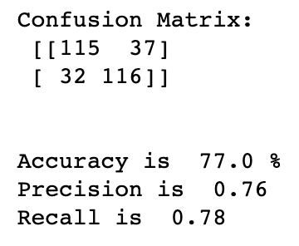
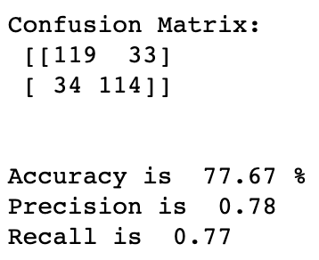
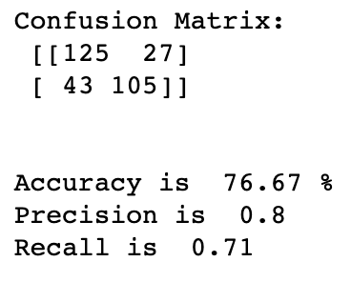
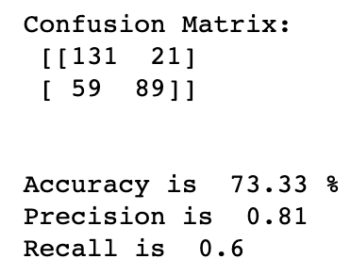
Predicting results
Random Forest
Bernoulli Naive Bayes
Multinomial Naïve Bayes
Logistic Regression

Slide 11
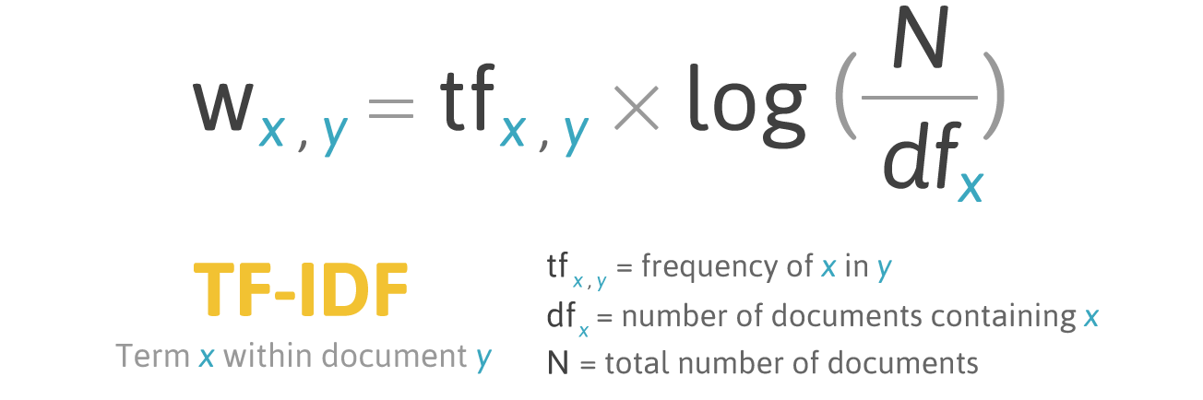
Extraction pipeline
Read Files
Tokenize the sentence
Frequency Matrix
TF (Term Frequency) :
count the number of a word appear in the document
IDF (Inverse Document Frequency) :
How common or rare a word is in the entire document set
TF Matrix
IDF Matrix
TF-IDF Matrix
Score the Sentences
Find the Threshold
Extract Salient Reviews

Slide 12

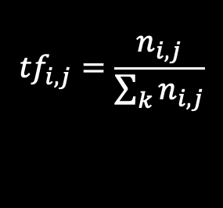
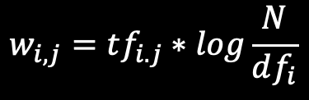
Sentence Score calculation
Frequency Matrix
Review 1 : wow : 1 love : 1 place : 1
Review 2 : crust : 1 good : 1
Review 3 : tasti : 1 textur : 1 nasti : 1
TFIDF Matrix
Review 1 : wow: 0.83 love: 0.50 place: 0.34
Review 2 : crust : 1.35 good : 0.54
Review 3 : tasti: 0.66 textur: 0.83 nasti: 0.83
TF Matrix
Review 1 : wow: 0.33 love: 0.33 place: 0.33
Review 2 : crust : 0.5 good : 0.5
Review 3 : tasti: 0.33 textur: 0.33 nasti: 0.33
Sentence Score
Review 1 : (0.83 + 0.50 + 0.34) / 3 = 1.67
Review 2 : (1.35 + 0.54 ) / 2 = 0.95
Review 3 : (0.66 + 0.83 + 0.83) / 3 = 0.77
$${tf}_{i,j}=\frac{n_{i,j}}{\sum_{k}{n_{i,j}}}$$
$$idf\left(w\right)=\log{\frac{N}{df_{t}}}$$
Document Frequency
Review 1 : wow: 3 love: 30 place: 96
Review 2 : crust : 2 good : 85
Review 3 : tasti: 10 textur: 3 nasti: 3
Threshold
Average sentence score of all reviews
(N = 1000)
$$w_{i,j}=tf_{i.j}∗log\frac{N}{df_{i}}$$
IDF Matrix
Review 1 : wow: 2.52 love: 1.52 place: 1.02
Review 2 : crust : 2.70 good : 1.07
Review 3 : tasti: 2.00 textur: 2.52 nasti: 2.52
Generate Summary
Select sentences with score larger than (threshold * k) to form a summary

Slide 13
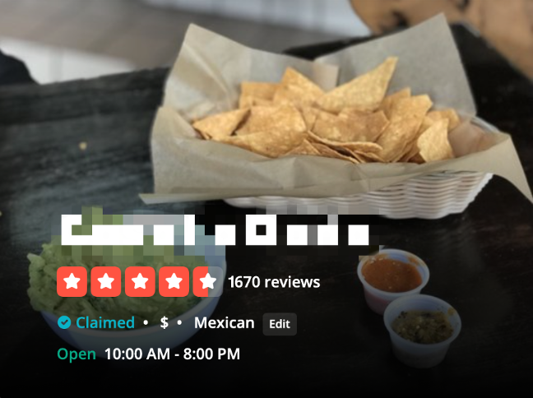
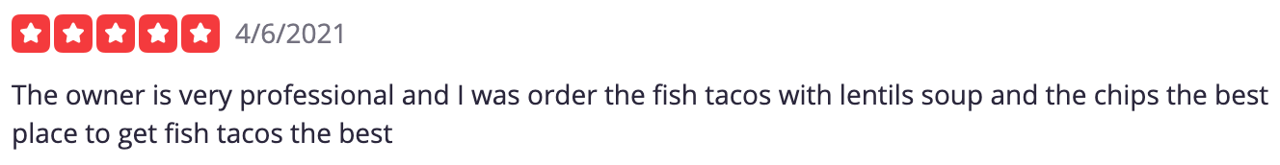
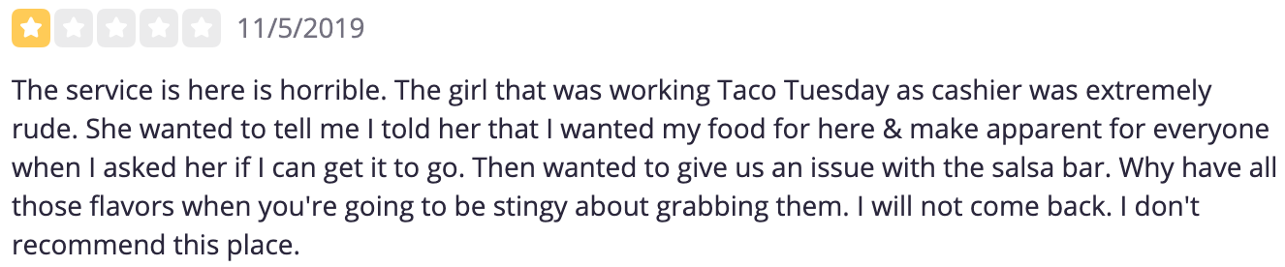
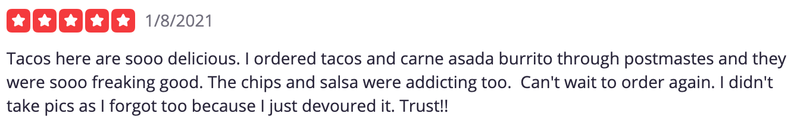
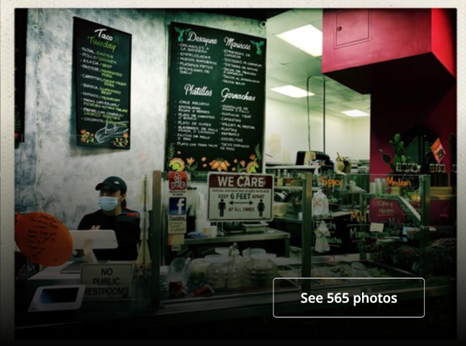
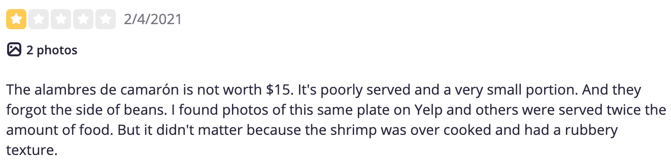
Restaurant reviews

Slide 14
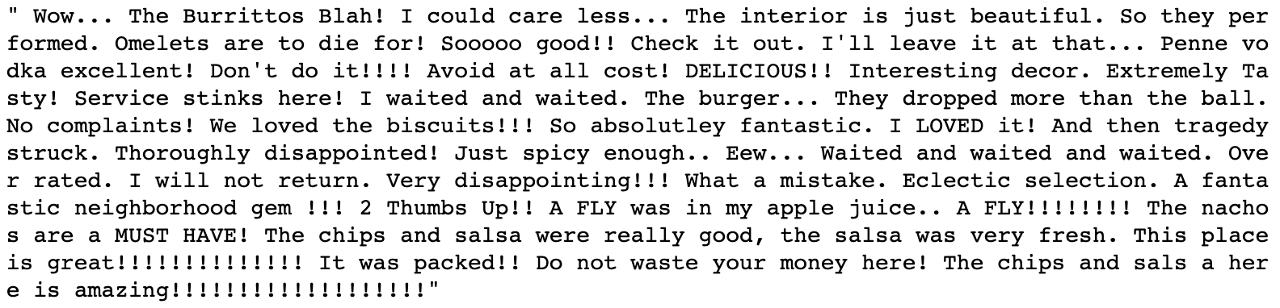
Salient User Review
Threshold * 2
Threshold * 5

Slide 15
Conclusion
Sentiment Analysis
Salient User Review
Improve Efficiency
Help Decision-Making

Slide 16
Thank you

